Slide 1
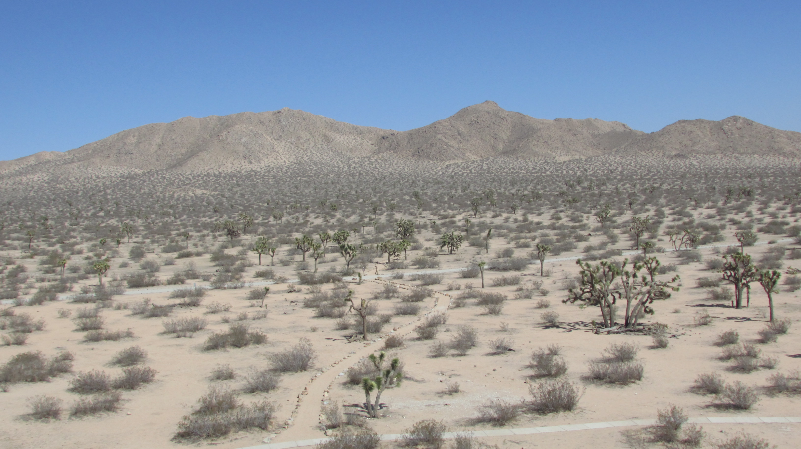
GET BEHIND ME SATAN!

Slide 2
GET BEHIND ME SATAN!
Let us look at some examples of how having the sun at your back helps to see things the way they really are.

Slide 3
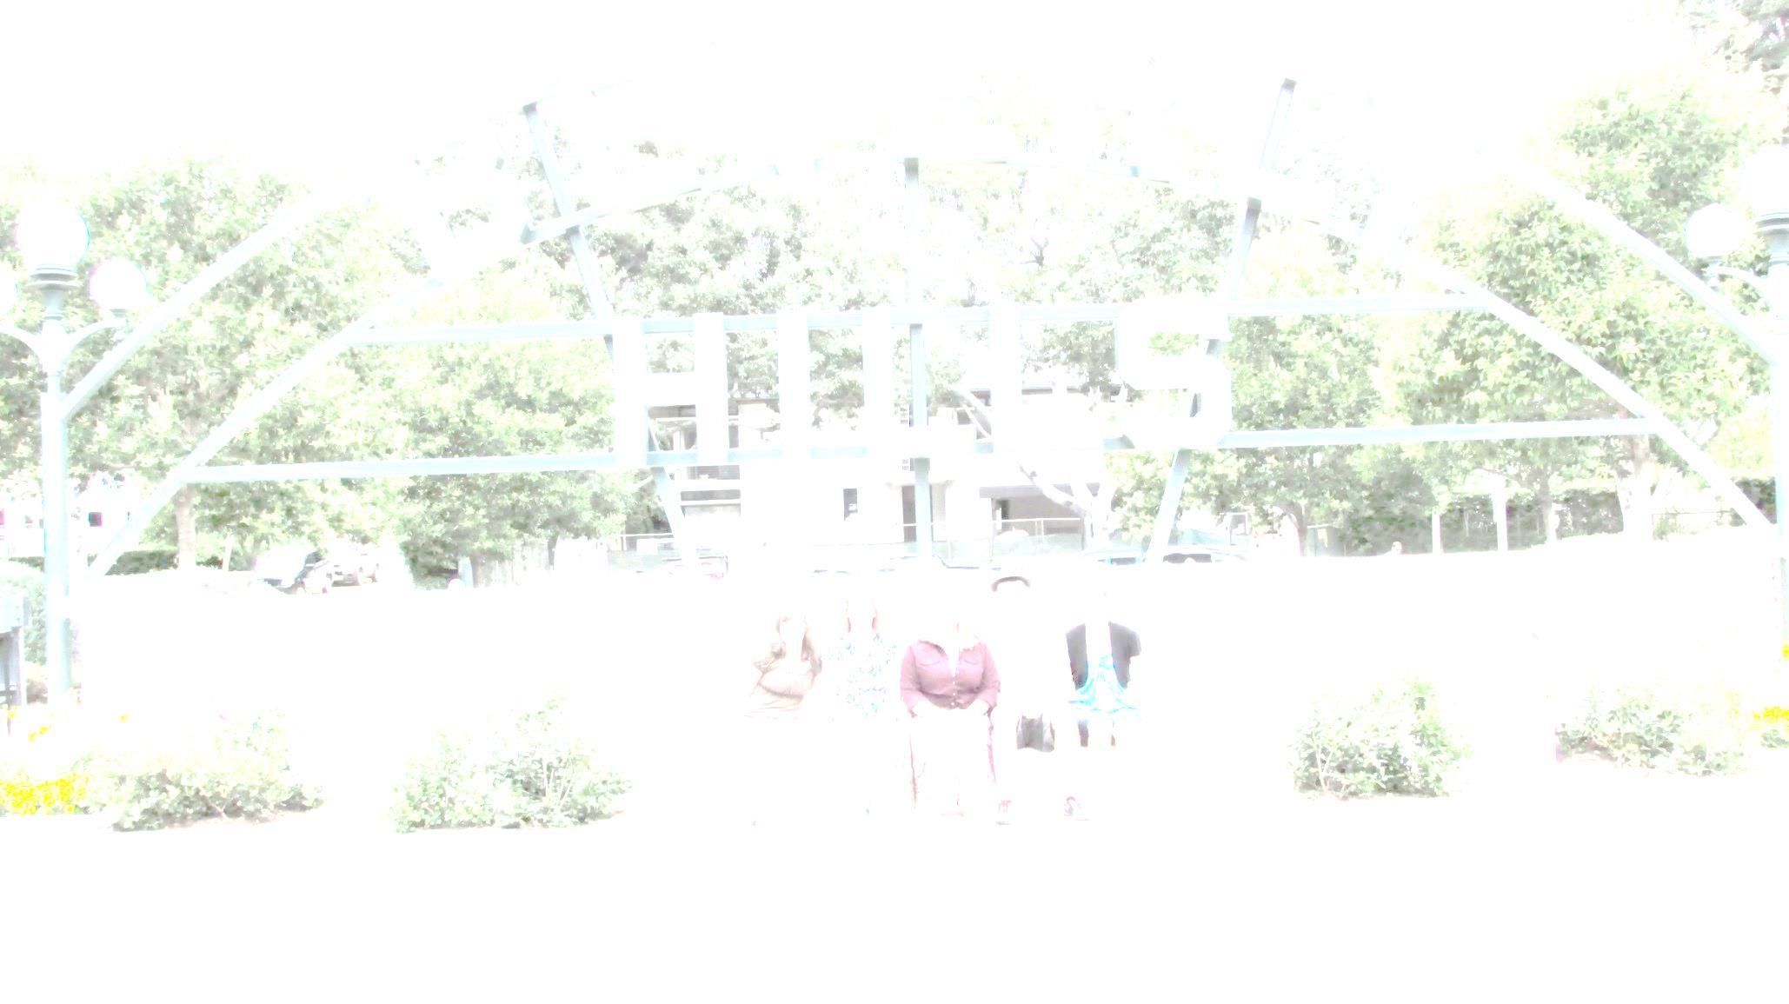

Slide 4


Slide 5


Slide 6
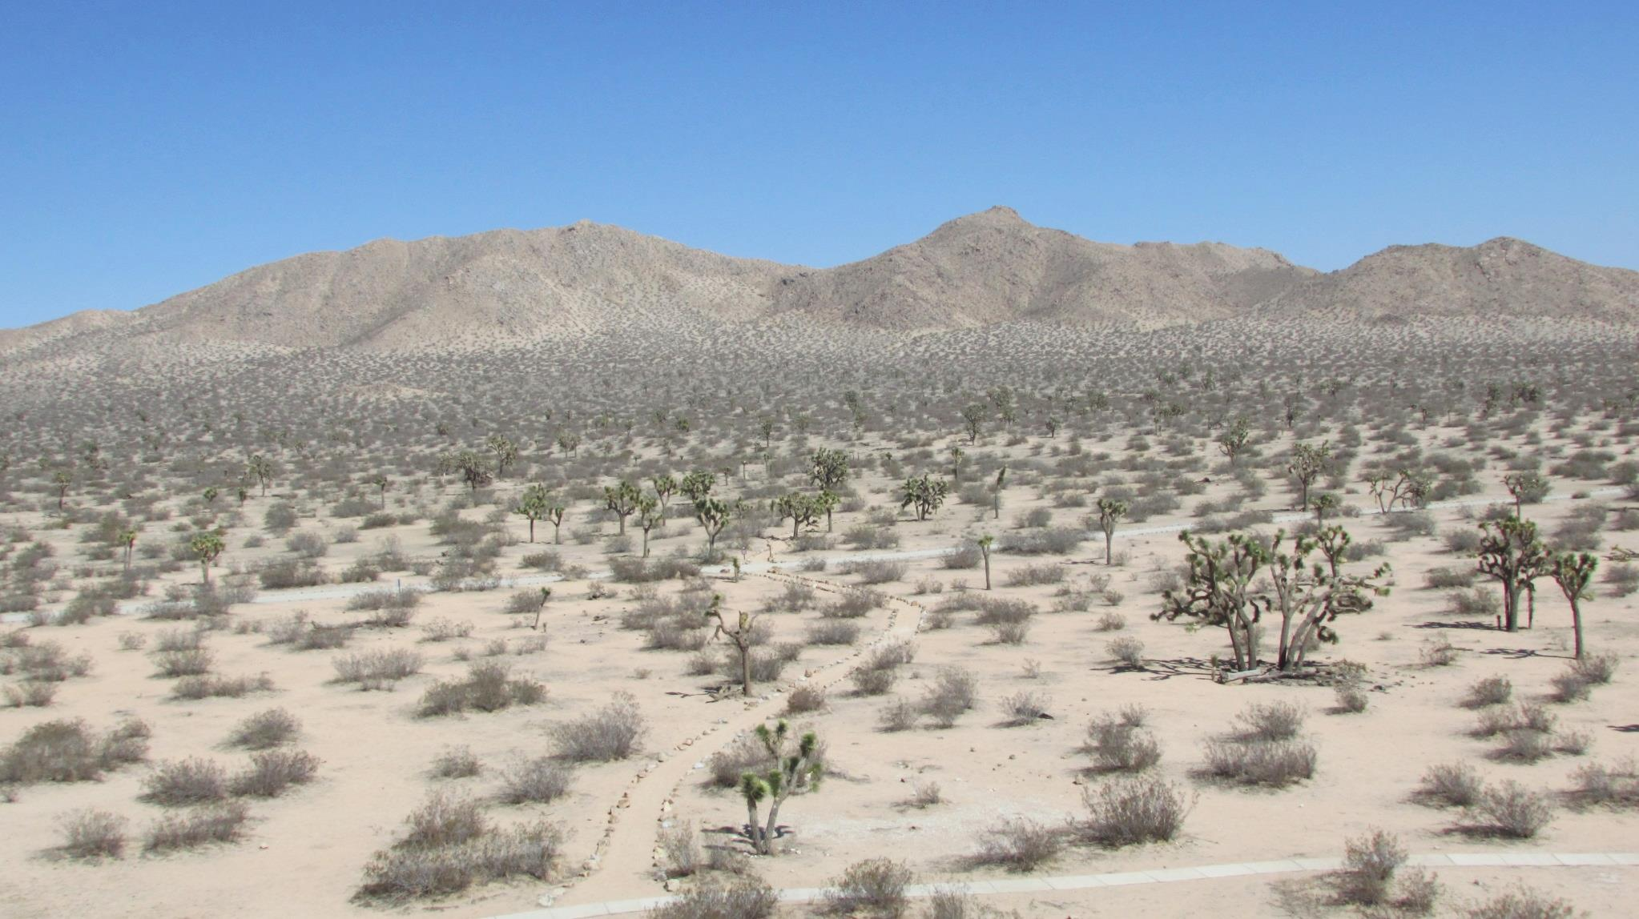

Slide 7
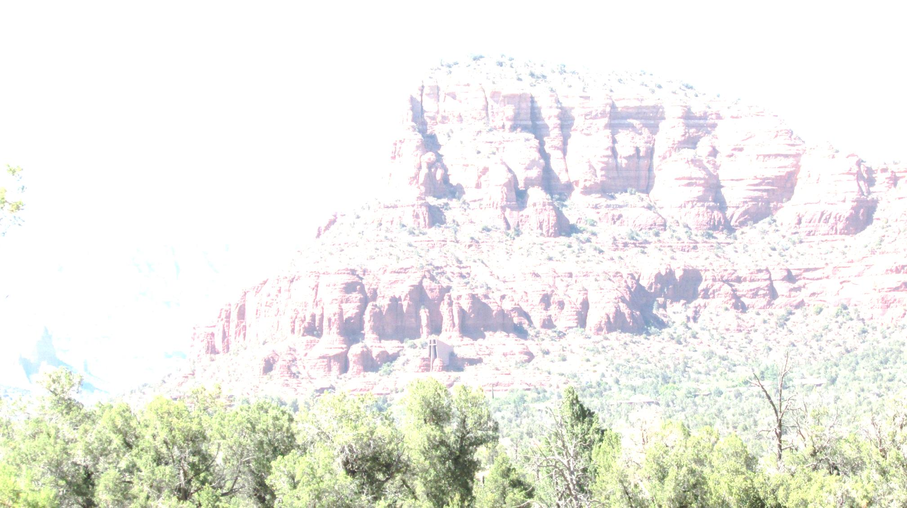

Slide 8
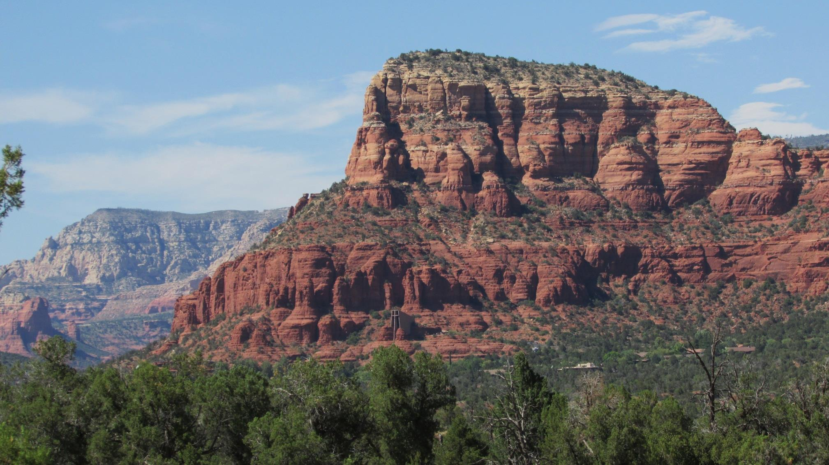

Slide 9


Slide 10
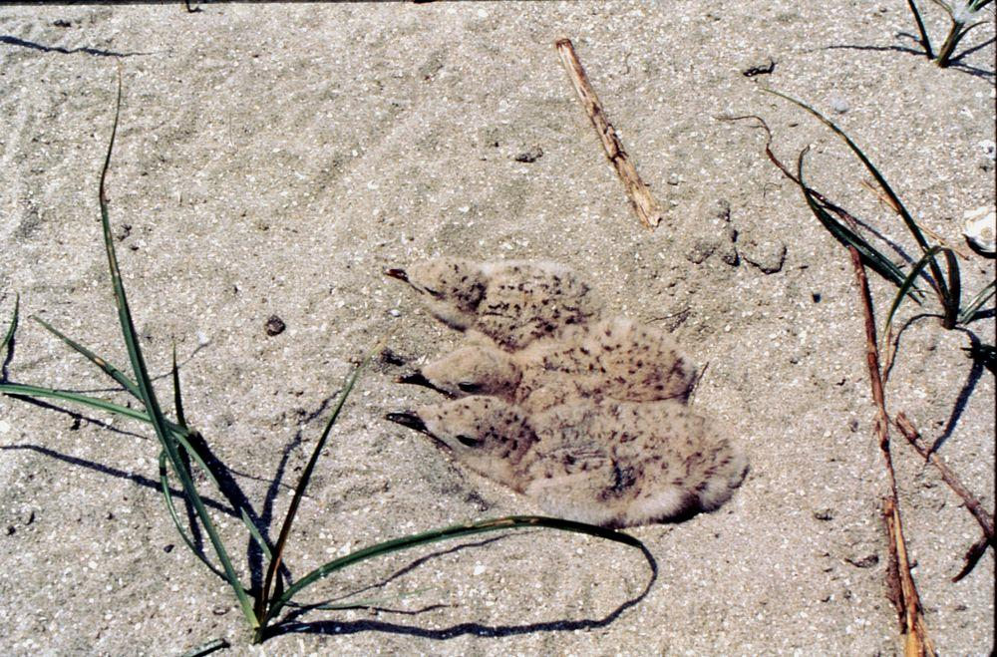

Slide 11
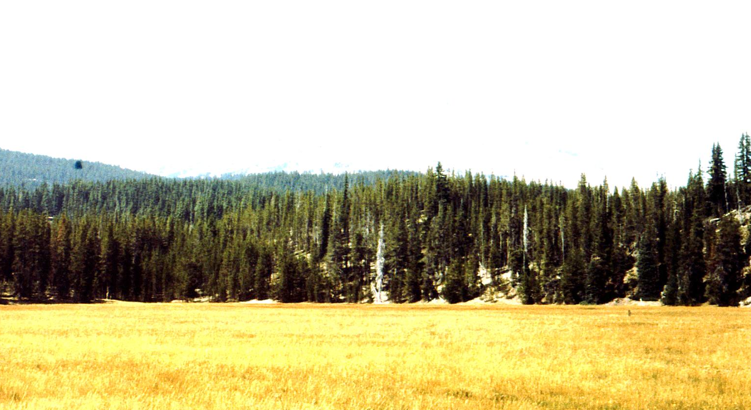

Slide 12
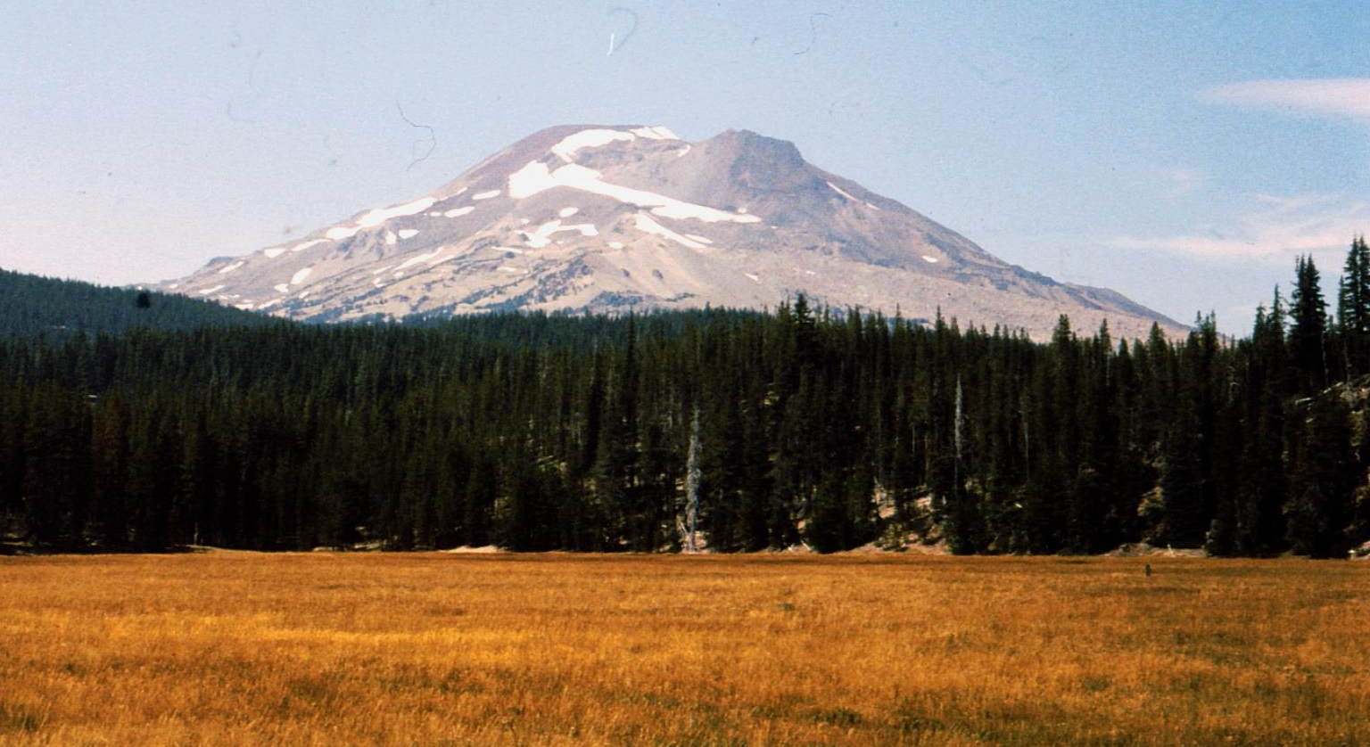

Slide 13
GET BEHIND ME SATAN!
Satan tried to get the Lord to see things his way in (Luke 4:1-13)

Slide 14
Luke 4:1-5 (NKJV): Then Jesus, being filled with the Holy Spirit, returned from the Jordan and was led by the Spirit into the wilderness, being tempted for forty days by the devil. And in those days He ate nothing, and afterward, when they had ended, He was hungry. And the devil said to Him, "If You are the Son of God, command this stone to become bread." But Jesus answered him, saying, "It is written, 'Man shall not live by bread alone, but by every word of God.' " Then the devil, taking Him up on a high mountain, showed Him all the kingdoms of the world in a moment of time.

Slide 15
Luke 4:6-13 (NKJV): And the devil said to Him, "All this authority I will give You, and their glory; for this has been delivered to me, and I give it to whomever I wish. Therefore, if You will worship before me, all will be Yours." And Jesus answered and said to him, "Get behind Me, Satan! For it is written, 'You shall worship the LORD your God, and Him only you shall serve.' " Then he brought Him to Jerusalem, set Him on the pinnacle of the temple, and said to Him, "If You are the Son of God, throw Yourself down from here. For it is written: 'He shall give His angels charge over you, To keep you,' "and, 'In their hands they shall bear you up, Lest you dash your foot against a stone.' " And Jesus answered and said to him, "It has been said, 'You shall not tempt the LORD your God.' " Now when the devil had ended every temptation, he departed from Him until an opportune time.

Slide 16
GET BEHIND ME SATAN!
Now let us consider some common situations when we need to get Satan behind us!

Slide 17
GET BEHIND ME SATAN!
When folks do not want to study

Slide 18
GET BEHIND ME SATAN!
Hebrews 10:24-25 (NKJV)
And let us consider one another in order to stir up love and good works, not forsaking the assembling of ourselves together, as is the manner of some, but exhorting (encouraging-ESV) one another, and so much the more as you see the Day approaching.

Slide 19
GET BEHIND ME SATAN!
2 Peter 3:17-18 (NKJV)
You therefore, beloved, since you know this beforehand, beware lest you also fall from your own steadfastness (lose your own stability-ESV), being led away with the error of the wicked; but grow in the grace and knowledge of our Lord and Savior Jesus Christ. To Him be the glory both now and forever. Amen.

Slide 20
GET BEHIND ME SATAN!
The early disciples experienced the same trials and found comfort in assembling with one another
(Acts 2:41-42, 11:18-26, 17:10-12, 19:8-10)

Slide 21
GET BEHIND ME SATAN!
When folks do not want to study
When our jobs are not going well

Slide 22
GET BEHIND ME SATAN!
Be thankful we have a job
Psalm 128:2 When you eat the labor of your hands, You shall be happy, and it shall be well with you.
Proverbs 13:11 Wealth gained by dishonesty (hastily-ESV) will be diminished, But he who gathers by labor (little by little-ESV) will increase.
Proverbs 14:23 In all labor there is profit, But idle chatter leads only to poverty.
Matthew 6:33 But seek first the kingdom of God and His righteousness, and all these things shall be added to you.

Slide 23
GET BEHIND ME SATAN!
Instead of spending time fretting about our job, we can use that time to shine the light of Jesus more. Remember Joseph in prison (Genesis 39:21-23) and Paul and Silas singing while in chains (Acts 16:25)? Now let us notice what Paul says:

Slide 24
GET BEHIND ME SATAN!
Philippians 2:14-16 (NKJV)
Do all things without complaining and disputing (grumbling or questioning-ESV), that you may become blameless and harmless, children of God without fault in the midst of a crooked and perverse generation, among whom you shine as lights in the world, holding fast the word of life, so that I may rejoice in the day of Christ that I have not run in vain or labored in vain.

Slide 25
GET BEHIND ME SATAN!
Colossians 3:22-25 (NKJV)
Bondservants, obey in all things your masters according to the flesh, not with eyeservice, as men-pleasers, but in sincerity of heart, fearing God. And whatever you do, do it (work-ESV) heartily, as to the Lord and not to men, knowing that from the Lord you will receive the reward of the inheritance; for you serve the Lord Christ. But he who does wrong will be repaid for what he has done, and there is no partiality.

Slide 26
GET BEHIND ME SATAN!
When folks do not want to study
When our jobs are not going well
When we have trouble finding a mate

Slide 27
GET BEHIND ME SATAN!
1 Timothy 1:5 (NKJV)
Now the purpose of the commandment is love from a pure heart, from a good conscience, and from sincere faith,
1 Timothy 4:12 (NKJV)
Let no one despise your youth, but be an example to the believers in word, in conduct, in love, in spirit, in faith, in purity.
1 Timothy 6:11 (NKJV)
But you, O man of God, flee these things and pursue righteousness, godliness, faith, love, patience, gentleness.

Slide 28
GET BEHIND ME SATAN!
2 Timothy 2:22 (NKJV)
Flee also youthful lusts; but pursue righteousness, faith, love, peace with those who call on the Lord out of a pure heart.
James 1:27 (NKJV)
Pure and undefiled religion before God and the Father is this: to visit orphans and widows in their trouble (affliction-ESV), and to keep oneself unspotted (unstained-ESV) from the world.

Slide 29
GET BEHIND ME SATAN!
When folks do not want to study
When our jobs are not going well
When we have trouble finding a mate
When loved ones are far away

Slide 30
GET BEHIND ME SATAN!
Rejoice we have a Father we can to pray to
Philippians 4:6-7 Be anxious for nothing, but in everything by prayer and supplication, with thanksgiving, let your requests be made known to God; and the peace of God, which surpasses all understanding, will guard your hearts and minds through Christ Jesus.

Slide 31
GET BEHIND ME SATAN!
Rejoice we have a Savior who always stands by us
2 Timothy 4:16-18 At my first defense no one stood with me (came to stand by me-ESV) , but all forsook (deserted-ESV) me. May it not be charged against them. But the Lord stood with me and strengthened me, so that the message might be preached fully (fully proclaimed-ESV) through me, and that all the Gentiles might hear. And I was delivered (rescued-ESV) out of the mouth of the lion. And the Lord will deliver (rescue-ESV) me from every evil work and preserve me for (bring me safely into-ESV) His heavenly kingdom. To Him be glory forever and ever. Amen!

Slide 32
GET BEHIND ME SATAN!
Rejoice we have a Savior who will never leave us
Hebrews 13:5-6 Let your conduct be without covetousness(keep your life free of the love of money-ESV); be content with such things as you have. For He Himself has said, "I will never leave you nor forsake you." So we may boldly say: "The LORD is my helper; I will not fear. What can man do to me?"

Slide 33
GET BEHIND ME SATAN!
Rejoice we have our Christian family
Mark 10:28-30 Then Peter began to say to Him, "See, we have left all and followed You." So Jesus answered and said, "Assuredly, I say to you, there is no one who has left house or brothers or sisters or father or mother or wife or children or lands, for My sake and the gospel's, who shall not receive a hundredfold now in this time--houses and brothers and sisters and mothers and children and lands, with persecutions--and in the age to come, eternal life."

Slide 34
GET BEHIND ME SATAN!
If we can get Satan behind us, our lives will be filled with the potential for good that the Lord wants us to see rather than the discouragement Satan wants us to see. God has given Christians many things to look forward to and a wonderful outlook for our lives. Let us be determined, like Jesus, to put Satan behind us! Then we will see things in the best possible light; in the way the Lord wants us to see. This positive outlook will help us be much more productive for Him in our lives.

Slide 35
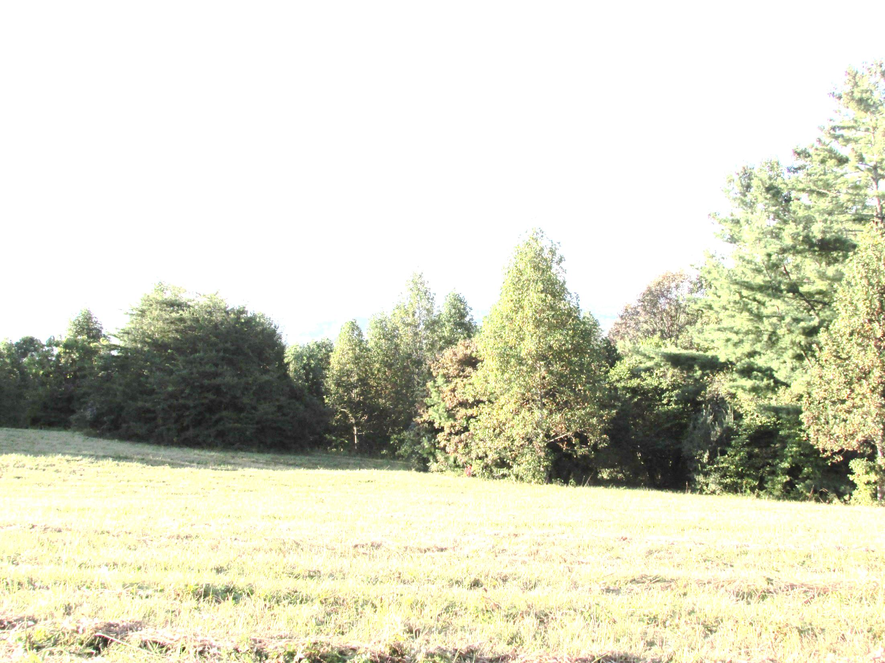

Slide 36
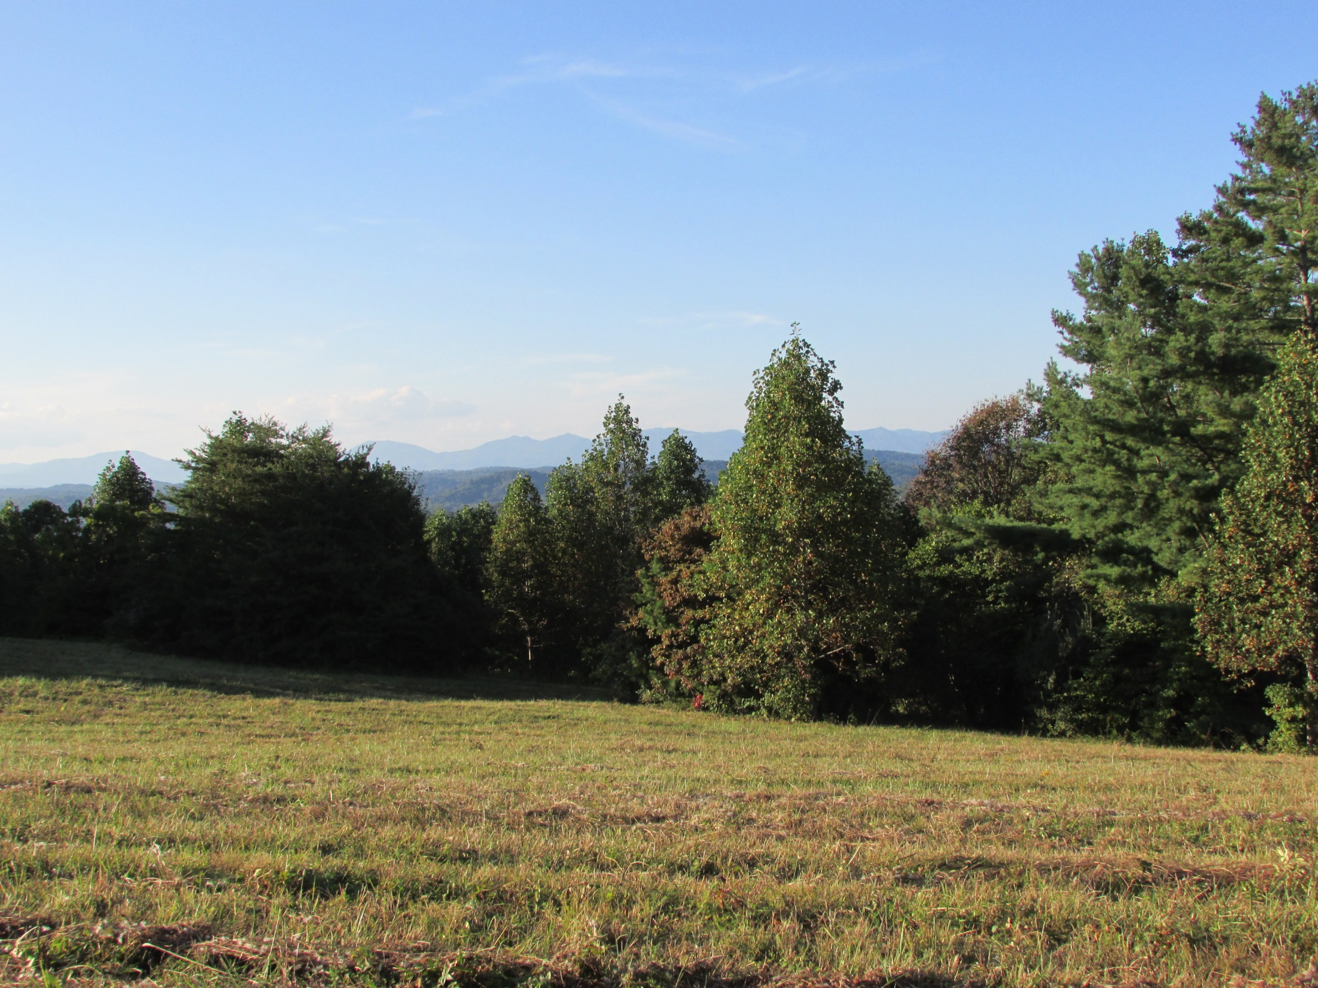

Slide 37
GET BEHIND ME SATAN!
If you are not a child of God today, your outlook for the future is very grim.
Why not get Satan behind you today?
He wants you to be content in your sins.
Why not come to Jesus and repent and be baptized to wash away those sins that hinder you?
And get Satan behind you for good!

Slide 38
GET BEHIND ME SATAN!

